Slide 1
Introduction to Coding
Moin Hasan

Slide 2
Option-1
Made a project that pulls data from five different webpages.
I made a project on the basis on crypto,weather,stocks,soccer and olympics.
For Crypto I took Yahoo.finance as a webpage, for weather as Accuweather, stock as moneycontrol , Soccer as espn and olympics as olympics.com.

Slide 3
Bullets accomplished
1 of the webpages includes data which changes daily
The 5 webpages are from 5 different websites
It does basic calculations on all 5 of those webpages
It uses BeautifulSoup on 1 of the webpages and parses the html
It produces 5 charts from all 5 of the webpages

Slide 4
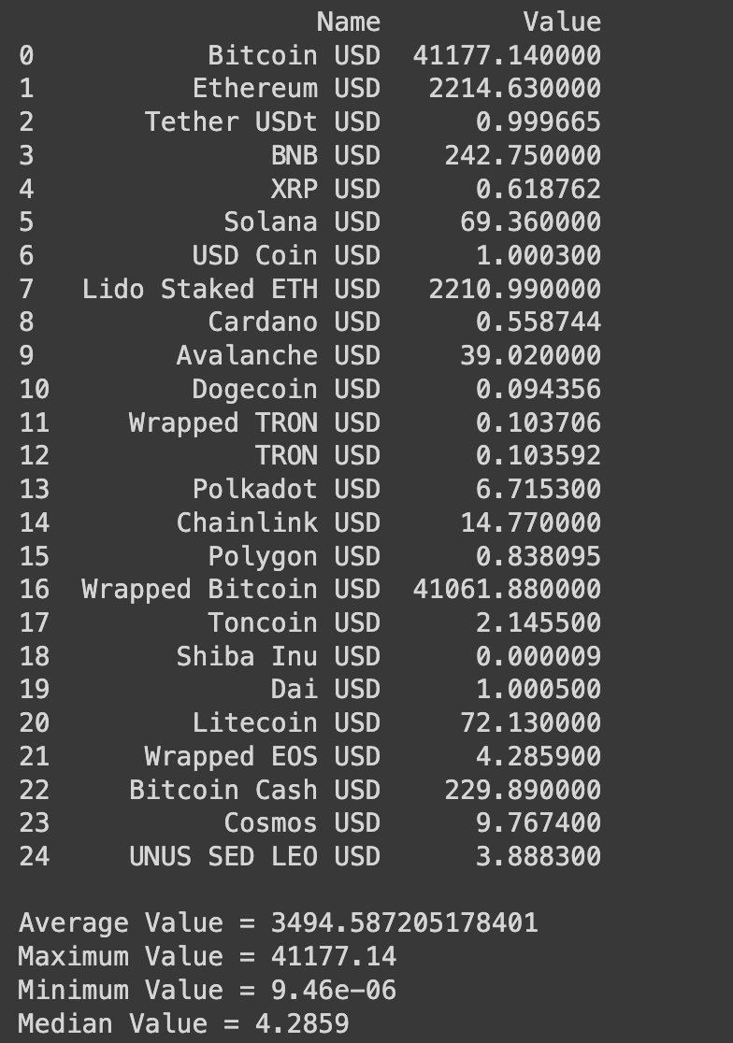
I setup headers for HTTP request.
For webscraping I used Beautiful Soup and it also phrases the HTML content of the webpages.
As said in the guideline I did basic numerical calculations using Numpy library.

Slide 5
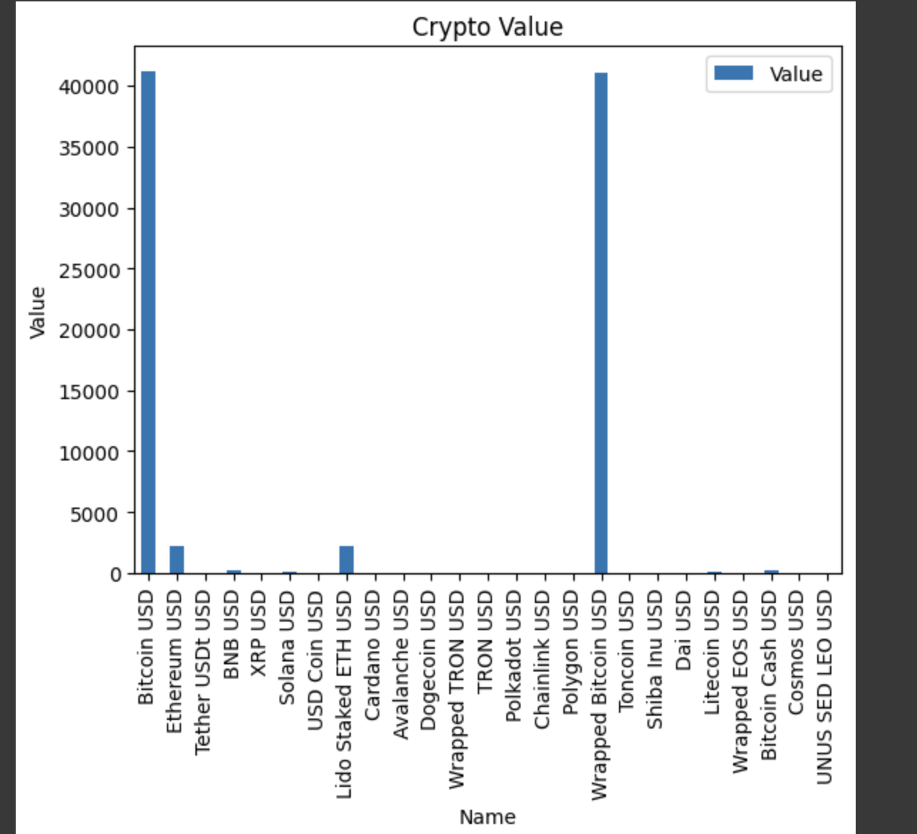
As said in the guidelines I drew charts(bar chart) for all the webpages using matpolib.
Used Pandas for valuations and analysis.

Slide 6
As the data on stocks, weather and Crypto changes daily I used the url of the website and used request.get method to fetch the data from it and I used request headers to get cookies from it.

Slide 7
For saving the data I used write() with a file handler which saves the data in a particular file.
file = open('output.txt', 'w')
file.write(data)
file.close()

Slide 8
What I learet?
Creating a Python project with the specified guidelines involves a variety of skills and concepts.
Web Scraping with Pandas and BeautifulSoup:
I gained experience in web scraping by using the pandas library to fetch data from different webpages.
BeautifulSoup was employed for parsing HTML on one of the webpages, demonstrating an understanding of both libraries.
Data Manipulation and Analysis:
I applied data manipulation techniques using Pandas, such as filtering, selecting, and cleaning data.
Basic calculations like mean, median, mode, min, and max were performed on numerical data from the webpages, showcasing your ability to analyze and extract insights from data.
Data Visualization:
I created at least charts from different webpages, showing your proficiency in data visualization.
This likely involved using libraries like matplotlib or seaborn to generate the charts.

Slide 9
File Handling:
I learned to save data to a file, which could involve various formats like CSV, Excel, or others.
This skill is essential for preserving the results of your analysis and sharing them with others.
Working with Multiple Websites:
Pulling data from five different websites required me to understand and navigate various HTML structures and potential challenges posed by different web servers.
Project Organization:
I learned the importance of organizing your code into functions, classes, or modules for better readability, reusability, and maintainability.
Understanding Web Technologies:
Through web scraping, I gained insights into how web pages are structured, the importance of understanding HTML, and potential issues related to web data extraction.
Overall, this project provided me with a comprehensive experience in data acquisition, manipulation, analysis, and visualization, while also exposing you to challenges commonly faced in real-world data science and web development scenarios.

Slide 10
Video references:
https://www.youtube.com/watch?v=O6nnVHPjcJU&t=189s
https://www.youtube.com/watch?v=ita82szjz-A
https://www.youtube.com/watch?v=OQA5tUBSEo4
https://www.youtube.com/watch?v=qdLb0hpuWcI&t=75s
https://www.youtube.com/watch?v=zXif_9RVadI

